Slide 1

Data Analysis of Government Dataset Rainfall Records
Exploring Rainfall Trends in India (Oct 2023)

Slide 2
Overview:
The dataset contains daily rainfall records collected by the National Remote Sensing Centre (NRSC) for the month of October 2023 across various districts in India. It consists of 16,929 records with seven columns, including State, District, Date, Year, Month, Avg_rainfall, and Agency_name. The contains a significant amount of missing values, particularly in the Avg_rainfall column, where nearly 50% of the entries are absent.
Since the data is sourced from the NRSC VIC Model, it is likely an estimation rather than direct observational data. This dataset can be valuable for climate analysis, weather forecasting, disaster management, and agricultural planning, provided the missing values are addressed appropriately.

Slide 3
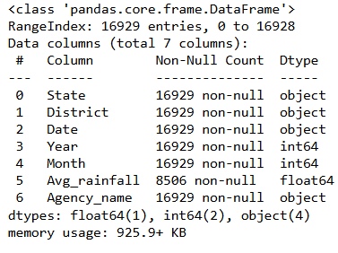
Dataset insight(info):

Slide 4
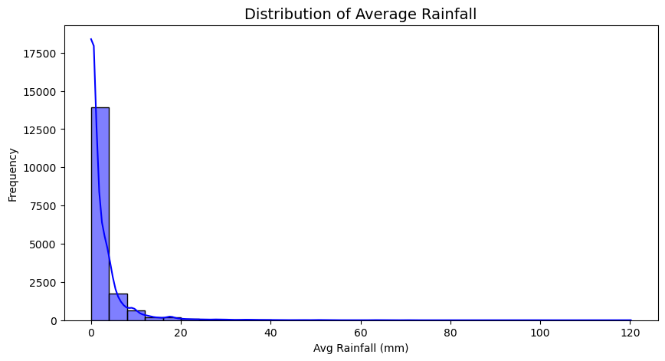
Data Analysis
Distribution of Average Rainfall.
The data is highly skewed to the right, meaning most of the observations are concentrated around low values of average rainfall.
There are a few instances of very high rainfall, but they are rare.

Slide 5
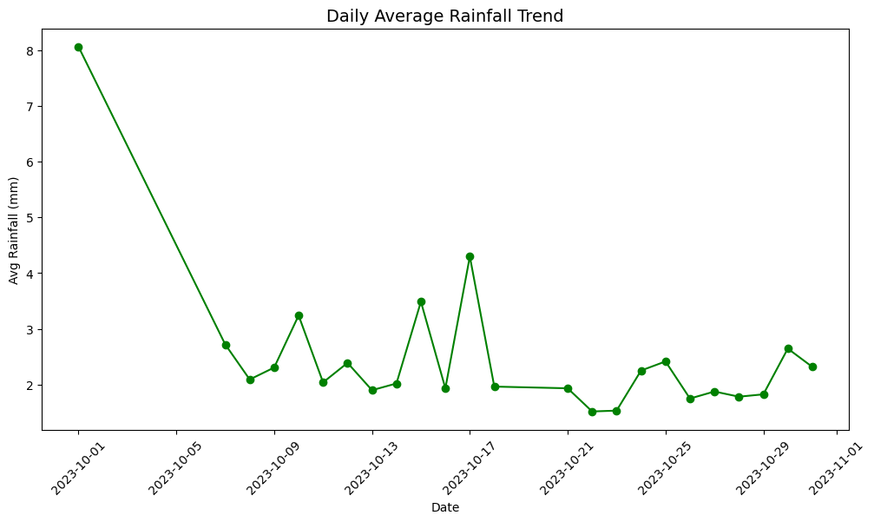
Daily Rainfall Trend
This line chart shows the daily average rainfall trend over the given time period.
The data suggests that rainfall was heavy at the beginning of the month but gradually reduced.
Mid-month spikes might indicate short rain spells.
Towards the end of the month, rainfall remains low and stable.

Slide 6
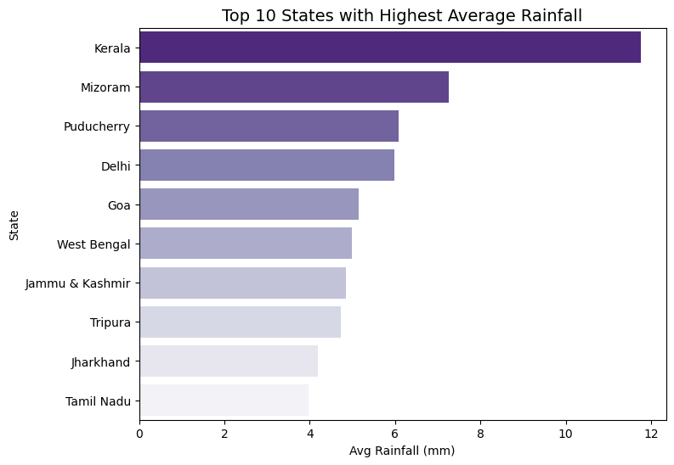
This horizontal bar chart highlights the top 10 states with the highest average rainfall.

Slide 7
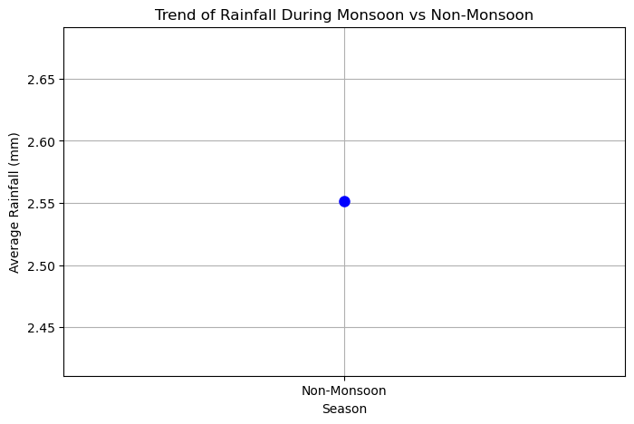
This scatter plot appears to show the trend of rainfall during monsoon vs. non-monsoon seasons.

Slide 8
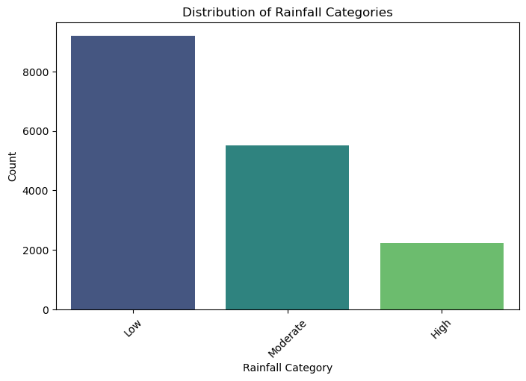
Here is the plot showing the distribution of rainfall categories based on the Rainfall category column.

Slide 9
Observations
Key observations from the data:
Some districts received significantly higher rainfall than others
Missing data might affect accuracy of trend analysis
Data patterns could support agricultural planning and disaster management
The dataset follows a daily format, which allows for time-series analysis of rainfall trends.

Slide 10
Conclusion
The dataset provides valuable insights into rainfall distribution in India.
Addressing missing data is crucial for accurate analysis
The data can aid in climate monitoring and disaster preparedness
Further exploration with predictive models could enhance forecasting.

